Slide 1
Sentalyzer 360
An Intelligent Customer Support and Feedback System With Sentimental Analysis
Prepared By:
Ahmad Barakat
Pruthvi Ingole
Roshan Issac
Monika Slominski

Slide 2
TABLE OF CONTENT
Introduction
Project Methodology
Project Schedule
Model Architecture
Solution Development
Solution Deployment
3
4
5
6
7
8
Sentalyzer 360

Slide 3

EXECUTIVE SUMMARY
Sentalyzer360 utilizes Natural Language Processing (NLP) to cluster customers and classify if a customer is happy, neutral or angry, and be able to match a customer service representative to keep the customer pleased. In a nutshell this project is not utilizing AI to replace customer support teams but using AI technology to make customer support more effective, and data driven.
Sentalyzer360 aims to help solution business owners and decision makers to:
Gain better insights and understand the factors that influence the customer opinions about a product and/or a service;
Enhance customer service processes by bringing customer feedback from multiple channels, into a single data lake to analyze;
Eliminate the time required to analyze customer sentiment and provide decision makers with real time insight on customer analytics.
Sentalyzer 360
An Intelligent Customer Support and Feedback System With Sentimental Analysis
Sentalyzer 360

Slide 4
PROJECT METHDOLOGY
Phase 1: Project Definition
Phase 2: Data Collection and Preparation
Phase 3: Model Development
Phase 4: Solution Deployment
1.1 Problem Definition
2.1 Data Collection
3.1 Data Segregation
4.1 Deployment Requirements
Specify business problem;
Identify AI use cases;
Define problem scope;
Identify data source;
Collect data and search for datasets;
Examine and analyze datasets
Select datasets
Select and set an evaluation protocol;
Split datasets into subsets;
Shuffle the records within each subsets;
Define deployment strategy (i.e on premises vs on cloud);
If Cloud, Assess and select cloud platform provider (i.e AWS, Azure, or Google);
Determine data pipeline and data integration;
Determine security requirements;
1.2 Solution Architecture
Design a high level solution architecture
2.1 Data Preparation
3.2 Model Development
Assesses the condition of the data;
Rectify and handle missing data;
Transform data;
Normalize data;
Clean and encode data;
Extract data features;
Transform data features;
Select data features
Analyze and define algorithm to be used;
Determine algorithm requirements;
Develop and architect model;
1.3 Project Requirements
4.2 Deployment Roadmap
Identify business and technical requirements;
Determine data requirements;
Identify data sources and data collection methodology
Develop Implementation Roadmap highlighting the deployment steps
3.3 Model Evaluation
Train Model using the train data subset;
Compare prediction against true values;
Refine model(s)/architecture;
Test and assess the performance of the model
Select the best model to be deployed.
4.3 Model Deployment
Transform and configure ML model and code to compile with cloud platform;
Create an endpoint configuration for an HTTPS endpoint;
Create an HTTPS endpoint
1.4 Data Requirements
Determine data requirements;
Design data for the model
Sentalyzer 360

Slide 5
PROJECT SCHEDULE
2020
 | January |  |  |  | February |  |  |  | March |  |  |  | April
Phase 1 - Project Definition
1.1 Problem Definition
1.2 Solution Architecture
1.3 Project Requirements
1.4 Data Requirements
Phase 2: Data Collection and Preparation
2.1 Data Collection
2.1 Data Preparation
Phase 3: Model Development
3.1 Data Segregation
3.2 Model Development
3.3 Model Evaluation
Phase 4: Solution Deployment
4.1 Deployment Requirements
4.2 Deployment Roadmap
4.3 Model Deployment
Now
Sentalyzer 360

Slide 6
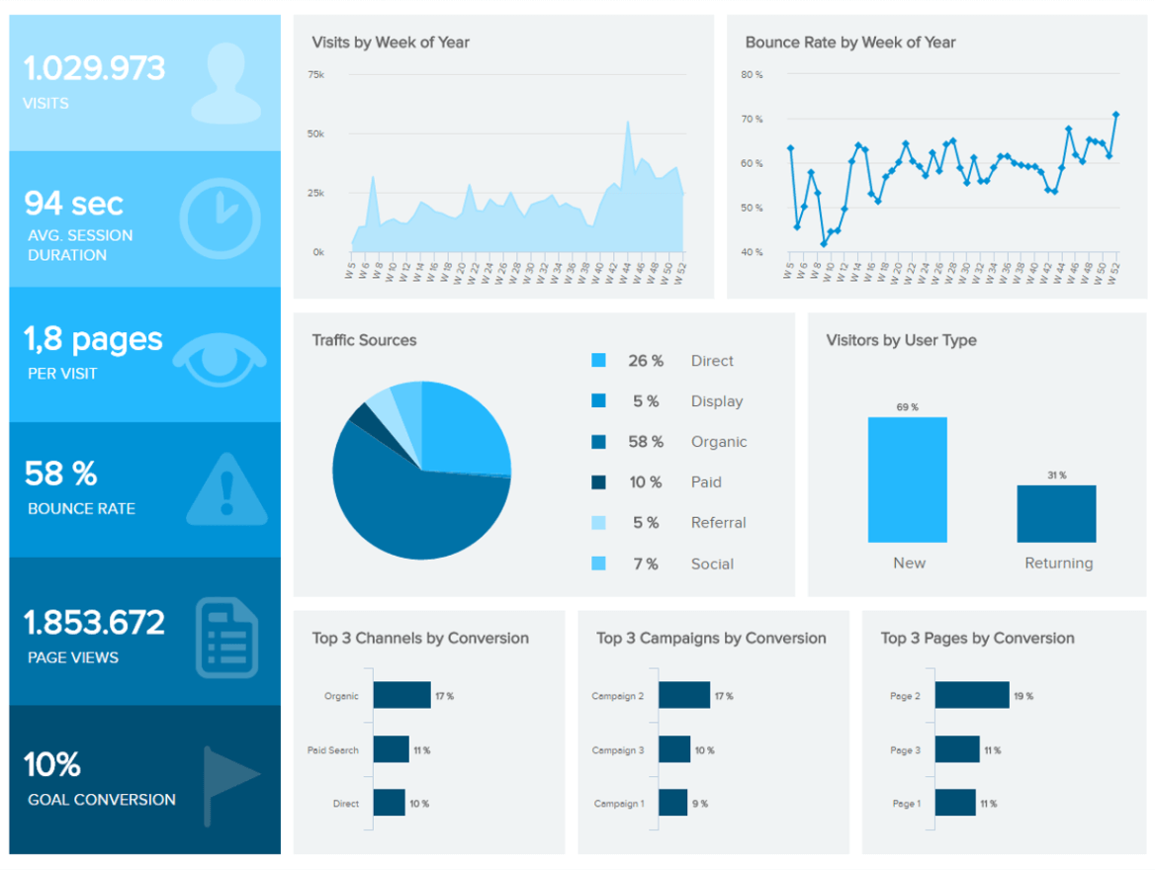
Model Architecture
High Level Model Design Architecture
Data Sources
Data Processing
Machine Learning Layer
Data Analytics
Data Visualization
Batch Processing
Natural Language Processing (NLP) - Written
Statistical Analytics
Online Reviews
Realtime Processing
Text Pre-processing
Semantic Analytics
Topic Model
Text Analytics
Voice Analytics
Sentiment Model
Twitter Data
Natural Language Processing (NLP) - Spoken
Predictive Modeling
Voice Processing
Speech to Text
Audi Pre-processing
Signal Processing
Emotion Detection
Voice Data
Sentalyzer 360

Slide 7

SOLUTION DEVELOPMENT
Your Great Subtitle Here
Accuracy
Accuracy
0.78
0.69
Accuracy
0.70
Accuracy
0.86
Accuracy
0.71
Sentalyzer 360

Slide 8






SOLUTION DEPLOYMENT
Your Great Subtitle Here
Data Sources
AWS S3
CSV
Online Reviews
AWS RDS
Audio
Voice Data
API
Twitter Data
Sentalyzer 360

